Slide 1
Divide-and-conquer approach
Text
Chapters 2

Slide 2
Divide and Conquer
What’s divide-and-conquer
How to analyze a divide-and-conquer algorithm
Examples: merge sort, binary search

Slide 3
What is divide and conquer
A technique for designing algorithms that decompose instance into smaller sub-instance of the same problem
  Solving the sub-instances independently
  Combining the sub-solutions to obtain the solution of the original instance

Slide 4
Divide-and-conquer
basic steps:
  divide the problem into sub-problems similar to original problem but smaller in size
  conquer the sub-problems recursively
  combine solutions to create solution to original problem

Slide 5
Merge Sort Algorithm
Divide: divide n-element sequence into two sub-sequences of n/2 elements each
Conquer: sort two sub-sequences recursively using merge sort
Combine: Merge the two sorted sub-sequences to produce the sorted answer

Slide 6
Merge Sort Algorithm
Merge-Sort A[1..n]
1. if n =1, done.
2. Recursively sort A[1..⎡n/2⎤ ] and A[⎡n/2⎤+1.. n ]
3. Merge the two sorted lists

Slide 7
Merging Two Sorted Lists
choose the smaller element of the two lists
remove it from list and put it into a list
repeat previous steps

Slide 8
Merge sort: top down
3 | 1 | 4 | 1 | 5 | 9 | 2 | 6 | 5 | 5 | 3 | 8 | 9
3 | 1 | 4 | 1 | 5 | 9 | 2 | 6 | 5 | 5 | 3 | 8 | 9
3 | 1 | 4 | 1 | 5 | 9 | 2 | 6 | 5 | 5 | 3 | 8 | 9
divide
3 | 1 | 4 | 1 | 5 | 9 | 2 | 6 | 5 | 5 | 3 | 8 | 9
1 | 3 | 4 | 1 | 5 | 9 | 2 | 5 | 6 | 3 | 5 | 8 | 9
Ad-hoc sort for each small instance

Slide 9
Merge sort: top down
1 | 3 | 4 | 1 | 5 | 9 | 2 | 5 | 6 | 3 | 5 | 8 | 9
merge
1 | 1 | 3 | 4 | 5 | 9 | 2 | 5 | 6 | 3 | 5 | 8 | 9
1 | 1 | 3 | 4 | 5 | 9 | 2 | 3 | 5 | 5 | 6 | 8 | 9
1 | 1 | 2 | 3 | 3 | 4 | 5 | 5 | 5 | 6 | 8 | 9 | 9

Slide 10
Merge two arrays
2 | 3 | 5 | 7 | 
1 | 4 | 5 | 6 | 9 | 

Slide 11
Merge two arrays
2 | 3 | 5 | 7 | 
1 | 4 | 5 | 6 | 9 | 
1

Slide 12
Merge two arrays
2 | 3 | 5 | 7 | 
1 | 4 | 5 | 6 | 9 | 
1 | 2

Slide 13
Merge two arrays
2 | 3 | 5 | 7 | 
1 | 4 | 5 | 6 | 9 | 
1 | 2 | 3

Slide 14
Merge two arrays
2 | 3 | 5 | 7 | 
1 | 4 | 5 | 6 | 9 | 
1 | 2 | 3 | 4

Slide 15
Merge two arrays
2 | 3 | 5 | 7 | 
1 | 4 | 5 | 6 | 9 | 
1 | 2 | 3 | 4 | 5

Slide 16
Merge two arrays
2 | 3 | 5 | 7 | 
1 | 4 | 5 | 6 | 9 | 
1 | 2 | 3 | 4 | 5 | 5

Slide 17
Merge two arrays
2 | 3 | 5 | 7 | 
1 | 4 | 5 | 6 | 9 | 
1 | 2 | 3 | 4 | 5 | 5 | 6

Slide 18
Merge two arrays
2 | 3 | 5 | 7 | 
1 | 4 | 5 | 6 | 9 | 
1 | 2 | 3 | 4 | 5 | 5 | 6 | 7

Slide 19
Merge two arrays
2 | 3 | 5 | 7 | 
1 | 4 | 5 | 6 | 9 | 
1 | 2 | 3 | 4 | 5 | 5 | 6 | 7 | 9

Slide 20
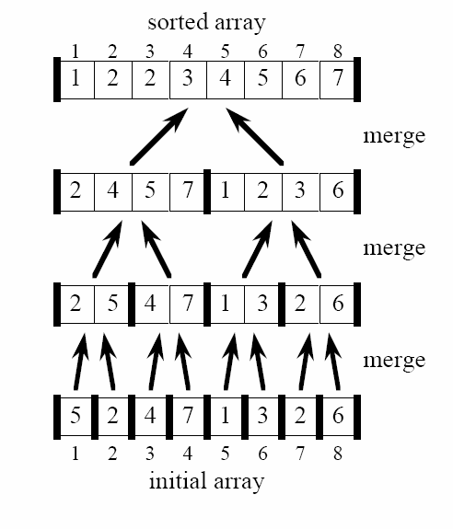
Merge Sort

Slide 21
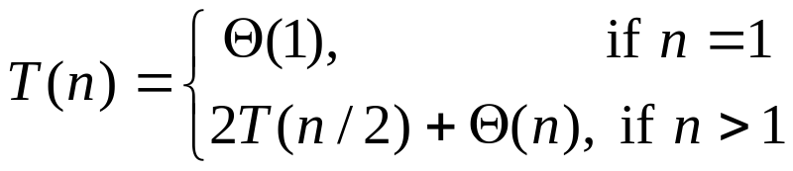
Analyzing Merge Sort
T(n)
Merge-Sort A[1..n]
1. if n =1, done.
2. Recursively sort A[1..⎡n/2⎤ ] and A[⎡n/2⎤+1.. n ]
3. Merge the two sorted lists
Θ (1)
Θ (⎡n/2⎤)+ Θ (⎣n/2⎦)
~ 2Θ (n/2)
Θ (n)
Recurrence:

Slide 22
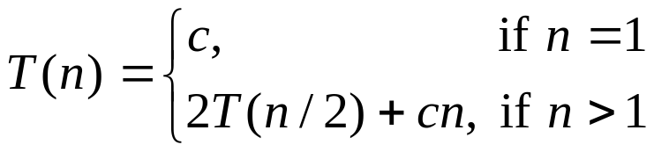
Recursion Tree
T(n) = cn lg n + cn = Θ (n lg n)

Slide 23
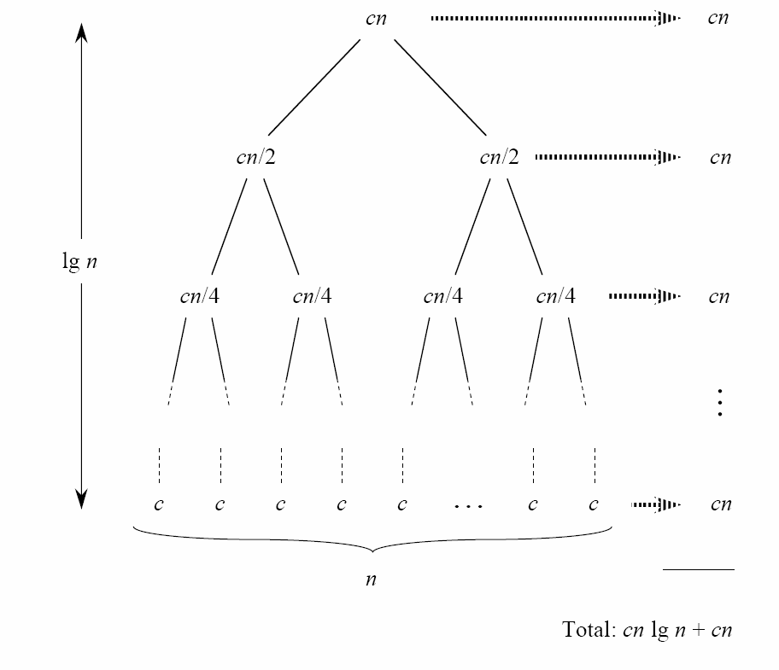
Recursion Tree

Slide 24
A general template
DC(x)
{
if (x is sufficiently small or simple)
adhoc(x); // use a basic sub-algorithm
decompose x into small instances x[0],..,x[l-1]; // divide
for (i=0; i<l; i++) //conquer
s[i] = DC(x[i]);
combine s[0],.., s[l-1] to obtain solution s for x; // combine
return s;
}
Three conditions to be considered
  When to use the basic sub-algorithm
  Efficient decomposition and recombination
  The sub-instances must be roughly the same size

Slide 25
Sequential Search from a sorted sequence
T[] is a sequence in nondecreasing order
Find an element in T[]
sequentialSearch(T[], x)
{
for (i=0; i<n; i++) {
if (T[i] >= x) // T[i-1]<x<=T[i]
return i;
}
}
Cost: best, worst, average?

Slide 26
Binary Search
Divide: check middle element
Conquer: recursively search 1 subarray
Combine: trivial

Slide 27
Binary Search
binaryRecursive(T[], i, j, x)
{
// we know T[i-1] < x <= T[j]
if (i==j)
return i;
k = (i+j)/2;
if (x <= T[k])
return binaryRecursive(T, i, k, x);
else
return binaryRecursive(T, k+1, j, x);
}
binarySearch(T[], x)
{
if (n==0 || x>T[n])
return n;
else
return binaryRecursive(T, 1, n, x);
}
Cost?

Slide 28
Binary Search: Example
3 5 7 8 9 12 15
3 5 7 8 9 12 15
3 5 7 8 9 12 15
12
3 5 7 8 9 12 15

Slide 29
Cost of binary search
T(n) = 1 T(n/2) + Θ(1)
work dividing and combining
number of sub-problem
size of sub-problem
T(n) = Θ(lg n)

